Slide 1

Restaurant & Consumer Data Analysis Using SQL
Understanding Customer Preferences, Restaurant Performance, and Rating Behavior

Slide 2
About me :
Education: B.Tech
Career Goal: Data Analytics / Data Science
Why Data Science: Interested in using data to solve real-world business problems
Experience: Fresher
Skills: Python • Pandas • SQL • Statistics • EDA • Web Scraping
LinkedIn | GitHub :
www.linkedin.com/in/jaanavi-velishoju-ba7864376
https://github.com/JaanaviVelishoju

Slide 3
Introduction :
This project uses a Restaurant & Consumer dataset containing information about consumers, restaurants, cuisines, preferences, and ratings.
The raw data was provided in CSV files and organized into a structured relational SQL database.
SQL was used to answer business questions related to customer behavior, restaurant quality, cuisine preferences, and location-based performance.
The project simulates a real-world analytics use case for a restaurant recommendation or customer-insights platform.

Slide 4
Business Problem Statement
A restaurant discovery or recommendation company needs to understand:
Which restaurants are performing well based on customer ratings?
Which cuisines and restaurant features attract customers?
How do consumer demographics, lifestyle, and budget affect ratings?
Which restaurants are underperforming compared with average ratings?
How can SQL help identify suitable restaurants for different customer segments?
Business goal:
Use SQL-based analysis to identify high-performing restaurants, understand customer preferences, and support better restaurant recommendations and marketing decisions.

Slide 5
Project Objectives
Convert raw CSV data into a structured relational database.
Understand relationships between consumers, restaurants, cuisines, preferences, and ratings.
Use SQL to filter, join, aggregate, rank, and compare data.
Analyze restaurant performance using overall, food, and service ratings.
Identify consumer segments based on occupation, budget, lifestyle, and cuisine preference.
Apply advanced SQL concepts such as CTEs, views, window functions, and stored procedures.
Convert query results into meaningful business insights.

Slide 6
Dataset & Data Source :
Dataset: Restaurant & Consumer Data
Source: provided course dataset. The original dataset was created for a restaurant recommender-system prototype and includes consumer profiles, restaurant information, cuisine data, and ratings.
File / Table | Purpose
consumers.csv | Consumer profile: ID, city, age, occupation, budget, smoker, drink level, transportation, marital status
consumer_preferences.csv | Cuisine preferred by each consumer
restaurants.csv | Restaurant details: name, city, price, alcohol service, parking, franchise, area
restaurant_cuisines.csv | Cuisine served by each restaurant
ratings.csv | Consumer ratings for restaurants: overall, food, and service ratings
data_dictionary.csv | Description of each column and its meaning

Slide 7
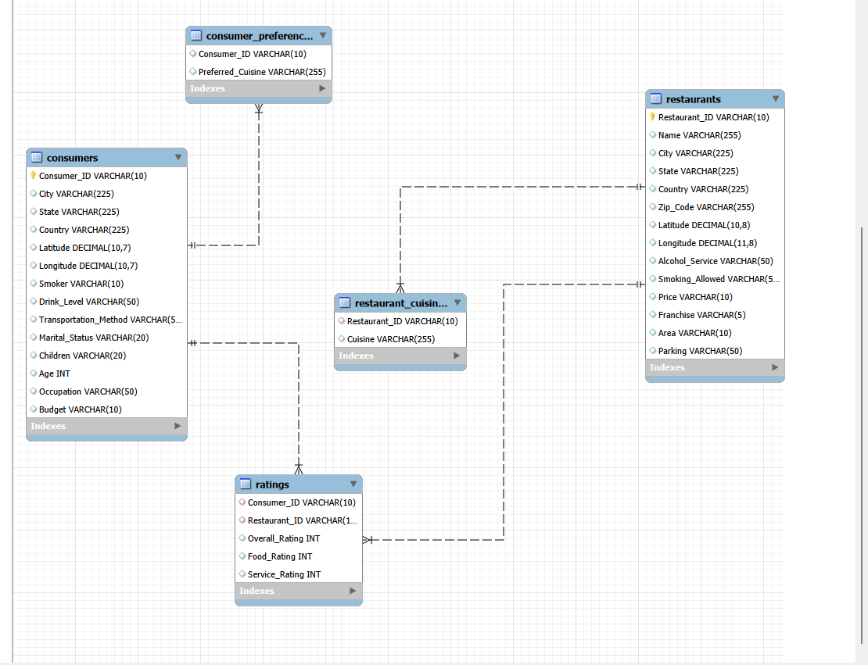
Database Structure ,Schema Overview &ER Diagram :
Consumer_ID is the primary key in consumers and a foreign key in consumer_preferences and ratings.
Restaurant_ID is the primary key in restaurants and a foreign key in restaurant_cuisines and ratings.
ratings is the central fact table connecting consumers and restaurants.
consumer_preferences and restaurant_cuisines are many-to-many mapping tables because one consumer can like many cuisines and one restaurant can serve many cuisines.

Slide 8
SQL Queries & Analysis Approach :
Analysis approach:
Data understanding: Reviewed tables, columns, data types, and relationships.
Basic filtering: Used WHERE to extract consumers, restaurants, and ratings based on conditions.
Relational analysis: Used JOIN to combine consumer, restaurant, cuisine, and rating data.
Aggregation: Used GROUP BY, COUNT, AVG, and HAVING to calculate rating performance.
Advanced analysis: Used subqueries, CTEs, derived tables, window functions, views, and stored procedures.
Insight generation: Interpreted results to answer business questions.
Example query explanation:
Sql :
SELECT Name, City, Alcohol_Service, Price FROM restaurants WHERE Alcohol_Service = 'Wine & Beer' AND Price = 'Medium';
What it does:
Filters restaurants that serve wine and beer and have a medium price level.

Slide 9
Key SQL Concepts Used :
SQL Concept | Where Used | Purpose
SELECT, WHERE | Basic filters | Retrieve specific rows based on conditions
JOIN | Consumer-restaurant-rating analysis | Combine related tables
GROUP BY | Restaurant and consumer analysis | Group records for aggregation
COUNT, AVG | Rating analysis | Count ratings and calculate averages
HAVING | Filter after aggregation | Filter groups based on aggregate values
Subqueries | Compare ratings with averages | Use one query result inside another query
CTEs | Complex multi-step analysis | Make queries readable and modular
Derived tables | Temporary result sets | Simplify nested logic
Window functions | ROW_NUMBER, RANK, LAG | Ranking and comparison within groups
Views | Reusable analysis logic | Store frequently used queries
Stored procedures | Parameter-based reporting | Reusable queries with inputs

Slide 10
Key Analysis Questions / Use Cases :
Basic Filtering Questions
Which consumers live in Cuernavaca?
Which consumers are students and smokers?
Which restaurants serve wine and beer at a medium price?
Join & Subquery Questions
Which restaurants received a highly satisfactory rating?
Which consumers rated restaurants in San Luis Potosi?
Which Mexican restaurants were rated by consumer U1001?
Aggregation & Advanced Questions
Which restaurants are highly rated Mexican restaurants?
Which are the top 2 restaurants for each cuisine?
What is each consumer’s spending segment and restaurant performance comparison?

Slide 11
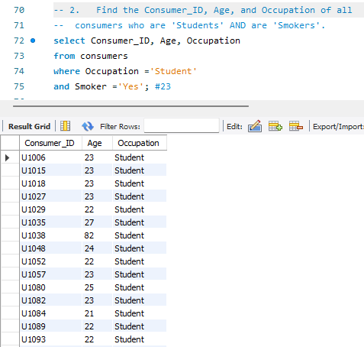
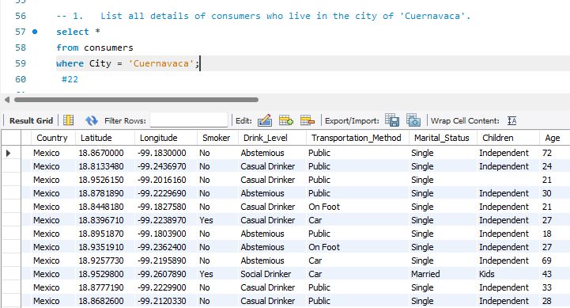
Query Results & Business Insights: Basic Filters
Query 1: Consumers in Cuernavaca :
Query 2: Student smokers
Insight:
Cuernavaca has 22 consumers in the dataset, making it an important location for local restaurant analysis.]
Insight:
23 students are smokers. This can help understand lifestyle-based customer segments.

Slide 12
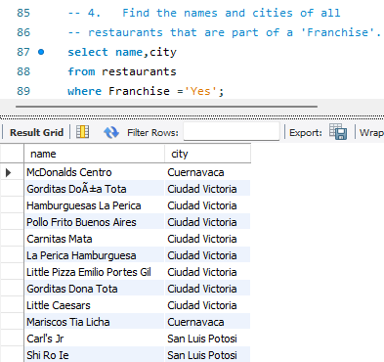
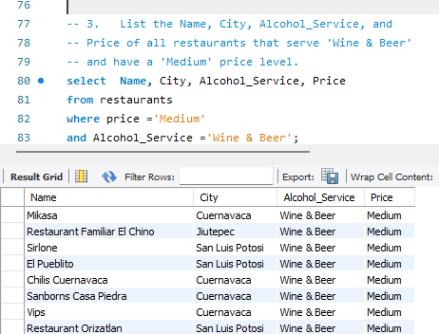
Query 4: Franchise restaurants
Query 3: Wine & Beer, Medium-price restaurants
Insight:
These restaurants may appeal to customers looking for moderate-cost dining with alcohol service.
Insight:
Franchise restaurants are present in 22 cities, indicating wider brand coverage.]

Slide 13
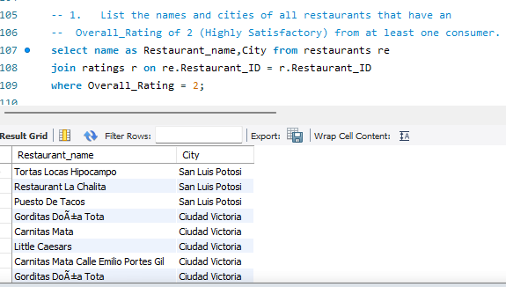
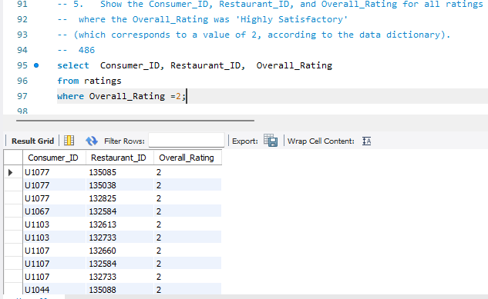
Query Results & Business Insights: Joins & Subqueries
Query 5: Highly satisfactory ratings
Query: Restaurants with at least one overall rating of 2
Insight:
486 ratings were highly satisfactory, showing which consumer-restaurant pairs had the best experience.
Insight:
These restaurants have demonstrated strong customer satisfaction at least once and can be considered for promotion.

Slide 14
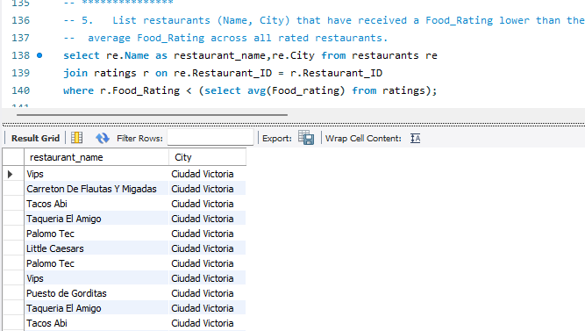
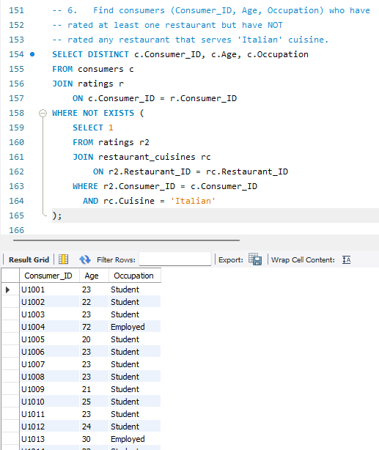
Query: Restaurants with food rating below average
Query: Consumers who rated restaurants but not Italian restaurants
What it does:
Compares each restaurant’s food rating with the average food rating across all ratings.
Insight:
[Restaurants below the average food rating may need improvement in food quality, menu consistency, or preparation.
Insight:
These consumers are active reviewers but have not engaged with Italian cuisine, representing a potential target group for Italian restaurant recommendations.

Slide 15
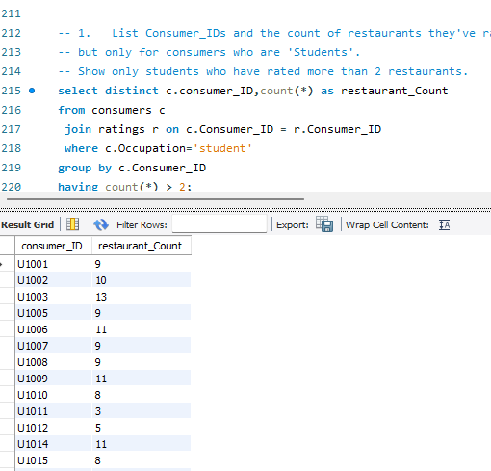
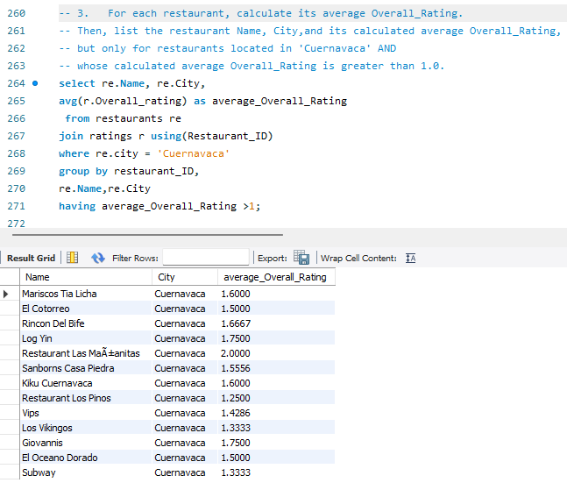
Query Results & Business Insights: Aggregations
Query: Students who rated more than 2 restaurants
Query: Average overall rating of Cuernavaca restaurants
Insight:
Restaurants in Cuernavaca with an average rating above 1.0 are relatively better performing and can be highlighted in recommendations.]
Insight:
These students rated more than two restaurants, indicating higher engagement among student consumers.

Slide 16
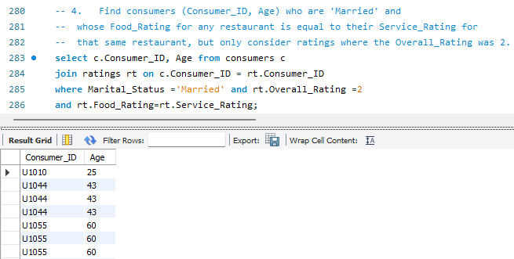
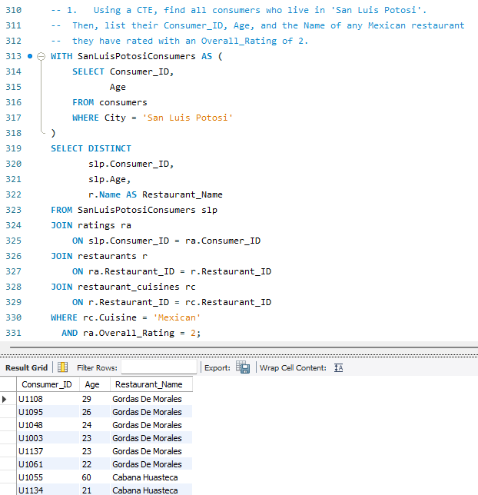
Query Results & Business Insights: CTEs & Window Functions
Query: Consumers whose food rating equals service rating
Query: San Luis Potosi consumers who rated Mexican restaurants with rating 2
What it does:
Uses a CTE to first identify consumers living in San Luis Potosi, then joins their ratings with Mexican restaurants.
Insight:
Local consumers in San Luis Potosi who prefer or rate Mexican food highly can be targeted with Mexican restaurant recommendations.
Insight: For these consumers, food and service experience were equally rated, suggesting consistent satisfaction or dissatisfaction across both factors.

Slide 17
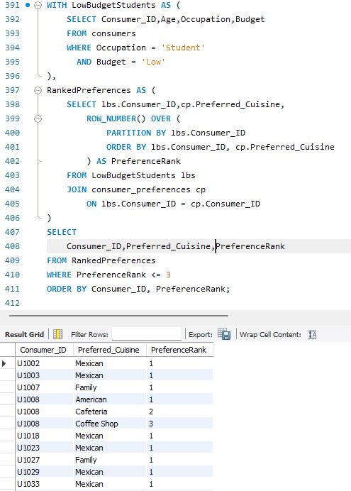
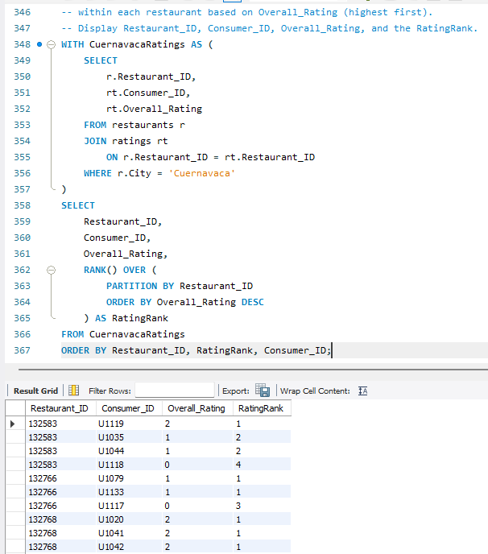
Query: Top 3 preferred cuisines for low-budget students
Query: Rank ratings within each Cuernavaca restaurant
"First, I used a CTE to filter consumers with a Low budget and student . -- Then one more CTE , joined them with the Consumer_Preferences table and used ROW_NUMBER() to rank their preferred cuisines. -- Finally, I selected the first three cuisines for each consumer.“
Insight:
The most common preferred cuisines among low-budget students can guide affordable restaurant recommendations.
What it does:
Uses ROW_NUMBER() or RANK() to rank ratings from highest to lowest within each restaurant.
Insight:
Ranking helps identify the best-rated customer experiences for each restaurant.

Slide 18
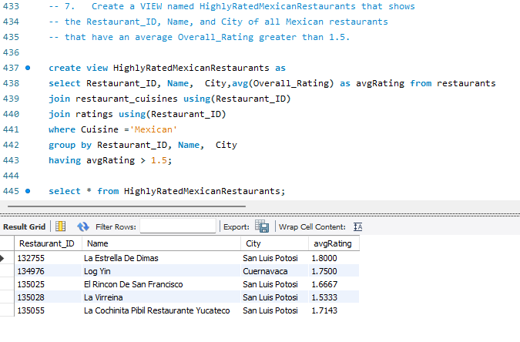
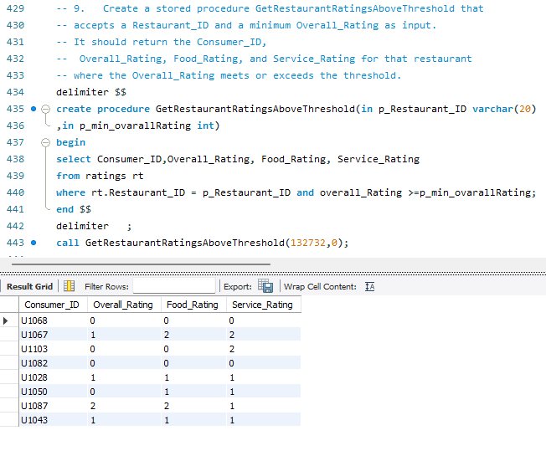
Query Results & Business Insights: Views & Stored Procedures
Stored Procedure: GetRestaurantRatingsAboveThreshold
Purpose:
View: HighlyRatedMexicanRestaurants
Purpose:
Accepts a Restaurant_ID and minimum rating, then returns matching consumer ratings.
Insight:
This procedure helps restaurant managers quickly view ratings above a chosen quality threshold.
Purpose:
Creates a reusable list of Mexican restaurants with an average overall rating above 1.5.
Insight:
These restaurants consistently receive strong ratings and are strong candidates for recommendations.

Slide 19
Key Findings :
Highly rated restaurants can be identified using average overall, food, and service ratings.
Consumer preferences vary by cuisine, budget, occupation, and location.
Students, employed consumers, and different budget groups show different rating and engagement patterns.
Some restaurants perform below the average food rating and may need operational improvement.
Mexican cuisine appears as an important cuisine category for both consumer preference and restaurant performance analysis.
CTEs, views, and stored proedures make complex analysis reusable and easier to maintain.
SQL can support restaurant recommendation, customer segmentation, and performance monitoring.

Slide 20
Challenges Faced :
Understanding relationships between multiple tables and choosing the correct join type.
Handling many-to-many relationships between consumers and cuisines, and restaurants and cuisines.
Writing correct GROUP BY and HAVING logic for aggregate conditions.
Avoiding duplicate rows when joining ratings with cuisine or preference tables.
Understanding SQL logical execution order: FROM → JOIN → WHERE → GROUP BY → HAVING → SELECT → ORDER BY.
Writing complex CTEs, window functions, and stored procedures correctly.
Interpreting rating values and converting technical results into business insights.

Slide 21
Future Improvements
Add data-cleaning steps to handle missing, inconsistent, or duplicate values.
Include restaurant visit date and time to analyze seasonal and time-based trends.
Build a dashboard using Power BI for visual analysis.
Develop a simple recommendation query or system based on consumer cuisine preferences, budget, city, and rating history.
Add more consumer attributes such as income, reviews, and visit frequency.
Use stored procedures and views to create reusable reports for business users.

Slide 22
Conclusion :
In this project successfully transformed restaurant and consumer CSV data into a relational SQL database.It is used to analyze customer demographics, cuisine preferences, restaurant features, and rating performance.This analysis helped to identified highly rated restaurants, low-performing restaurants, active consumers, and cuisine-based customer segments.Advanced SQL concepts were applied to solve real-world business questions.The project demonstrates how SQL can support data-driven decisions in the restaurant or other industries.

Slide 23

THANK YOU

